Slide 1
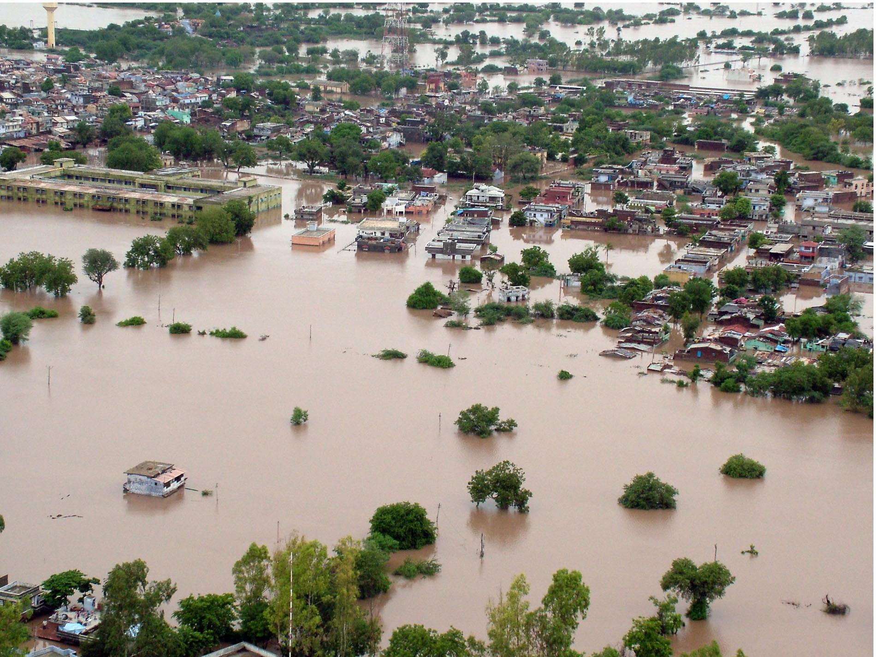
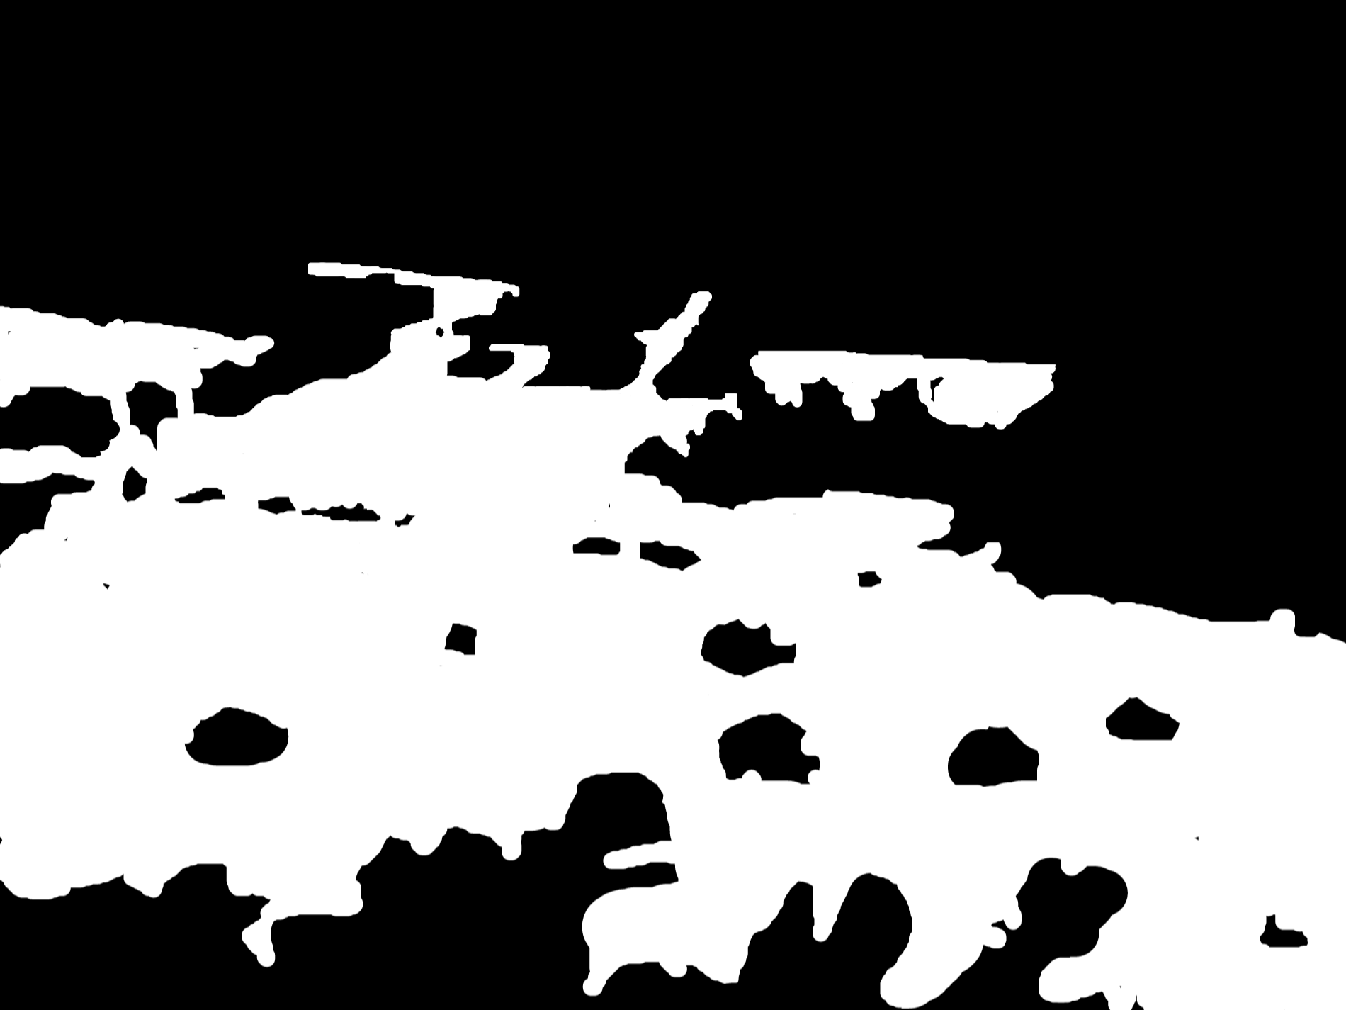
Flood Impact Detection on Areas Using U-Net
Shaoun Chandra Shill Fahim Ahmed ifty
23373005 23266007
Tuhin Ahmed Effat Jahan
23173004 24366047
GROUP - 06

Slide 2
Project Idea
Design a U-net model for the classification and segmentation of parts of road images in Bangladesh affected by flood. This would be useful for evaluating the effects of floods on road construction as a way of determining the extent of damage in areas that experience flood ravages during certain seasons of the year. Segment out flooded region of roads in Bangladesh using satellite images or from any aerial view.

Slide 3
What is the Unet
U-net is an encoder-decoder-based convolutional self-design network for image segmentation developed for biomedical image analysis in recent years. Its distinctive U-shape is formed by two main parts: A road within which the magnitude grows, the said encoder is the road that is the compressing dimension, and the extended road is a decoder. The contracting layers decrease the context of this load inversely, the expansive part increases this context by reconstructing the features which concatenated with features that can be obtained from the encoder part through the Skip connection. The connection links make it possible to reproduce geo-spatial correlation if the image affords correct spatial relations; geometric and photo-realistic attributes of the environment, the chained levels of spatial hierarchy, and the segmentation feature of complicated images with high accuracy even though only a few samples are taken. This is well exemplified by the U-Net architecture because it is fulfilling the segmentation function and is very helpful to medical image analysis because the task normally gets down to pixel level.

Slide 4
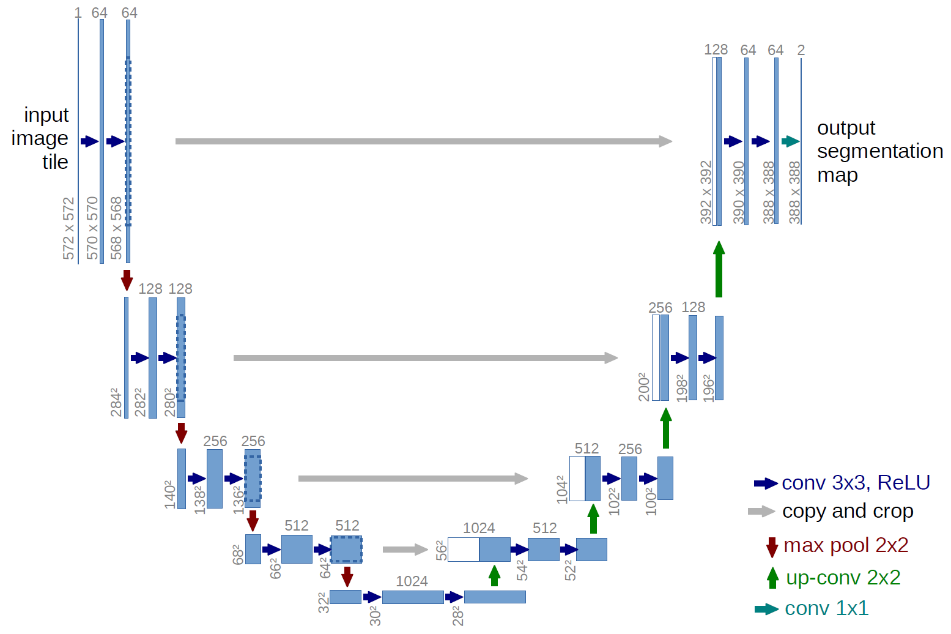
Unet Architecture
U-net was originally invented and first used for image segmentation. Its architecture can be broadly thought of as an encoder network followed by a decoder network.

Slide 5
Related Works
U-Net and Variants
Related Works
Deep Learning for Image Segmentation
Image Data Augmentation in Segmentation
Application in Medical Imaging

Slide 6
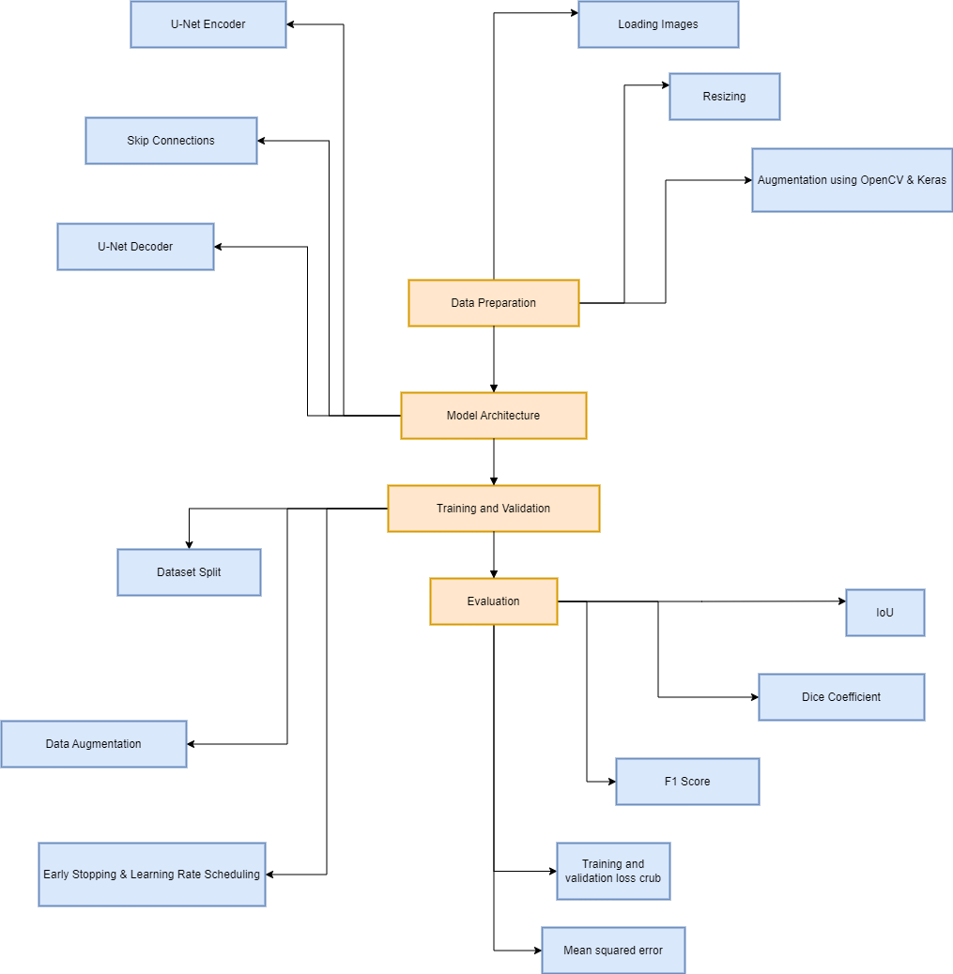
Methodology

Slide 7
Data Preparation
Dataset: Images and Corresponding Masks
Libraries: Python (OS, glob), OpenCV (cv2)
Preprocessing: Image resizing, normalization, augmentation
Image Augmentation: Rotation, flipping, and zooming (via Keras' ImageDataGenerator) to boost generalization and prevent overfitting

Slide 8
Model Architecture
Contracting Path (Encoder)
Expanding Path (Decoder)
Skip Connections
Tools: TensorFlow, Keras
Optimizer: Adam
Loss Function: Binary Cross-Entropy or Dice Loss for segmentation accuracy

Slide 9
Training & Validation
Data Split: Training and validation sets
Augmentation: Applied to the training set for better generalization
Techniques: Early stopping, learning rate scheduling, and model checkpoints to avoid overfitting and optimize training

Slide 10
Evaluation
IoU (Intersection over Union): Measures overlap between predicted and true masks
Dice Coefficient: Evaluates the accuracy of the segmentation
F1 score: The F1 score is the harmonic mean of precision and recall, balancing both.
MSE: Mean Squared Error measures the average squared difference between predicted and actual values.
Training and Validation loss curve: Training and validation loss curves show model performance over epochs.
Visualisation: Side-by-side comparison of predicted masks and ground truth for insight into performance

Slide 11
Result Analysis

Slide 12
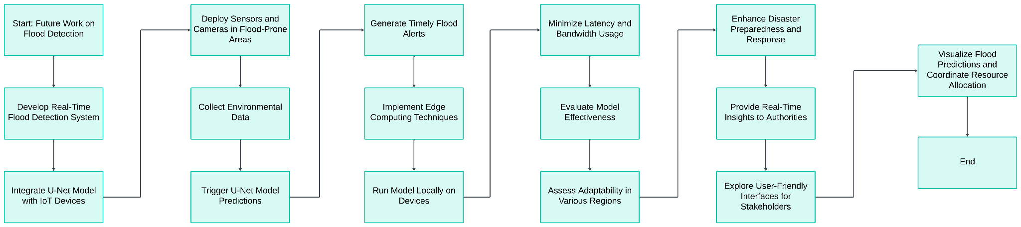
Future Works

Slide 13
Conclusion
In recent years, computer vision techniques have been widely applied to flood detection and monitoring systems. This paper compares three image segmentation methods: thresholding, region growing, and hybrid techniques, concluding that the hybrid approach achieved the best performance with over 74% segmentation accuracy. While these methods were effective, switching algorithms for different images remains a challenge. Semantic segmentation and deep learning approaches, particularly a U-Net based CNN model, were explored for satellite imagery with promising results. Future work aims to improve segmentation precision by incorporating geometric hints and uncertainty-weighted multi-task loss.

Slide 14
Project Dataset
Flood Area Segmentation
Link : https://www.kaggle.com/datasets/faizalkarim/flood-area-segmentation

Slide 15
Reference
U-Net: Convolutional Networks for Biomedical Image Segmentation. link - https://doi.org/10.48550/arXiv.1505.04597
Image Segmentation Methods for Flood Monitoring System. link - https://doi.org/10.3390/w12061825
Road Extraction by Deep Residual U-Net. link- https://arxiv.org/pdf/1711.10684
Satellite Image Segmentation for Building Detection using U-net. link - https://cs229.stanford.edu/proj2017/final-reports/5243715.pdf

